Slide 1
Rugtomize
Kaelyn Contardi, Zohra Feroz
Tim Kozhevnikov, Rashi Shah

Slide 2
Intro to the Company
Founded by former Chapman Alumni- Amir
Start up in Orange county
Authentic woven persian rugs custom made to order, designed worldwide hand tailored in California.
The company takes ideas and designs and creates customized rugs instantly.
The process is quick and the rugs are made instantly within 48 hours.
They offer multiple tools for design such as colors, shapes, images,text, and layers that truly enable the consumer to “create” a rug they will fall in love with.
Notes:
Zohra

Slide 3
Strengths
SWOT Analysis
Weaknesses
Unique market opportunity
First mover advantage
Unique combination of history and modern production
Speed of production
Customization
Lack of Brand Recognition
Start up level
No investment in marketing yet
Beta version of the website- even when launched some parts of the website were still missing

Slide 4
Opportunities
SWOT Analysis
Threats
Partnerships
Influencers
Possible Marketing opportunities
Already well established rug companies
Competitors have more money
2nd mover advantage
Overall economy

Slide 5
Where the Company Stood
Unclear on target market
Using too many hashtags, and not the right ones
Website still in beta version
Twitter rarely updated (last update 7/19/18)
Pinterest hasn’t been updated in 2 months, 1 follower
Instagram Captions lacked flare
Notes:
Kaelyn
Screenshots show they were using attractive captions and hashtags to create an online presence, so we made a reccomendation on using the both

Slide 6
Instagram

Slide 7
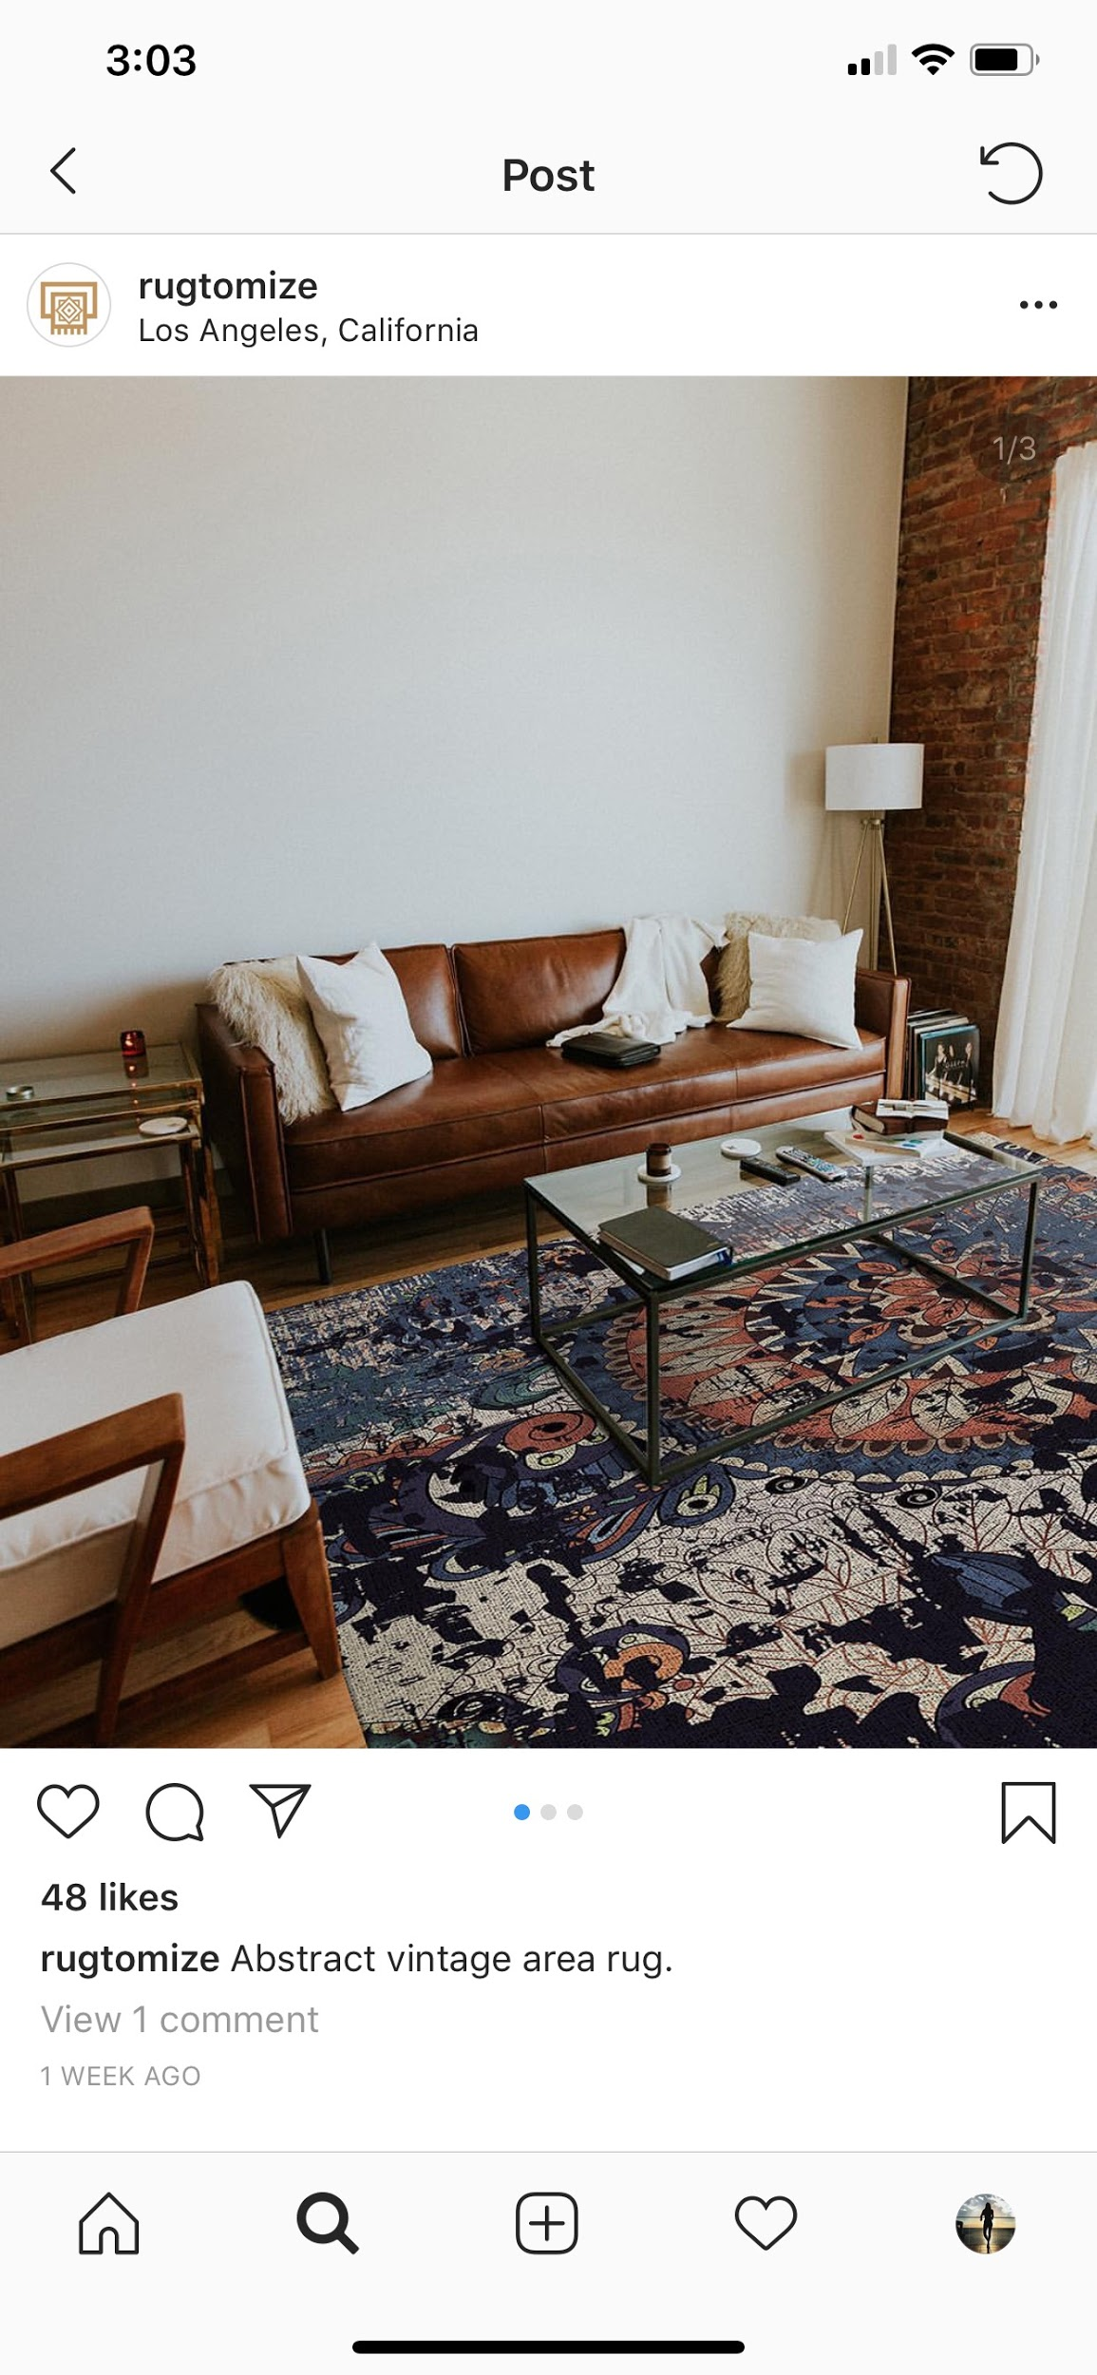
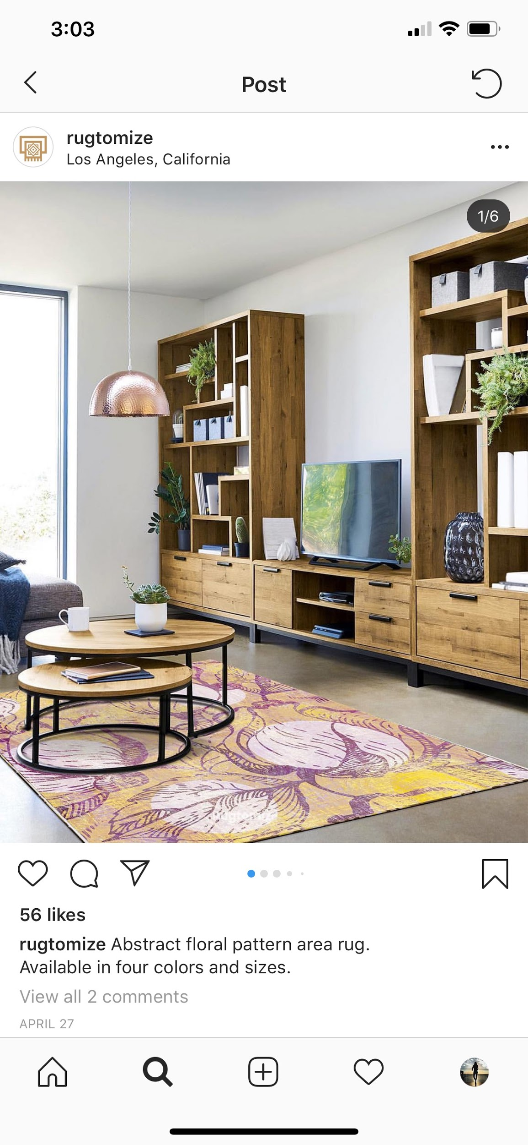
Old Posts
Very basic captions, not creative
Too many hashtags (in the comments)
Positive: rugs draw your eye
Not many comments and likes
No tags
Notes:
kaelyn

Slide 8
Twitter and Pinterest

Slide 9
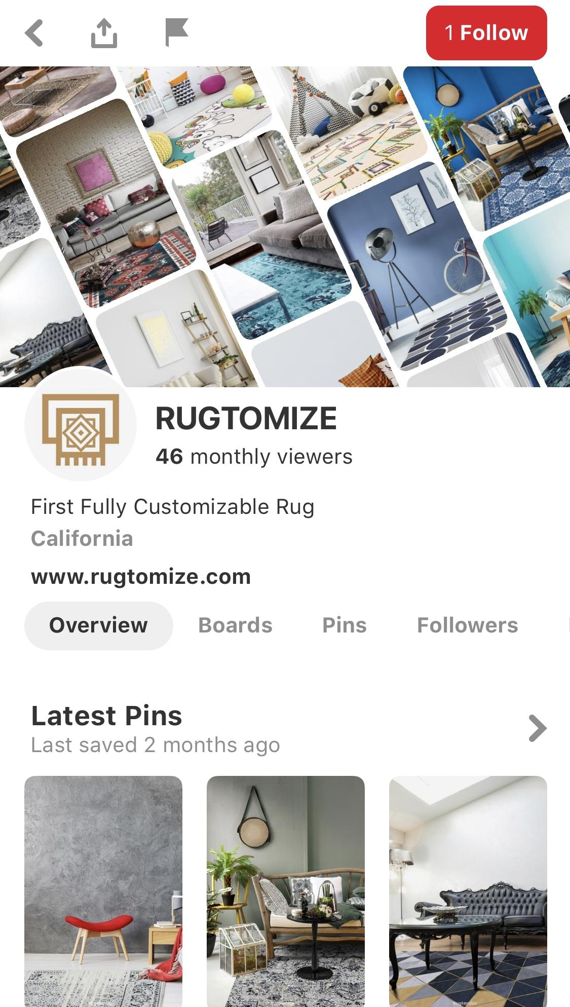
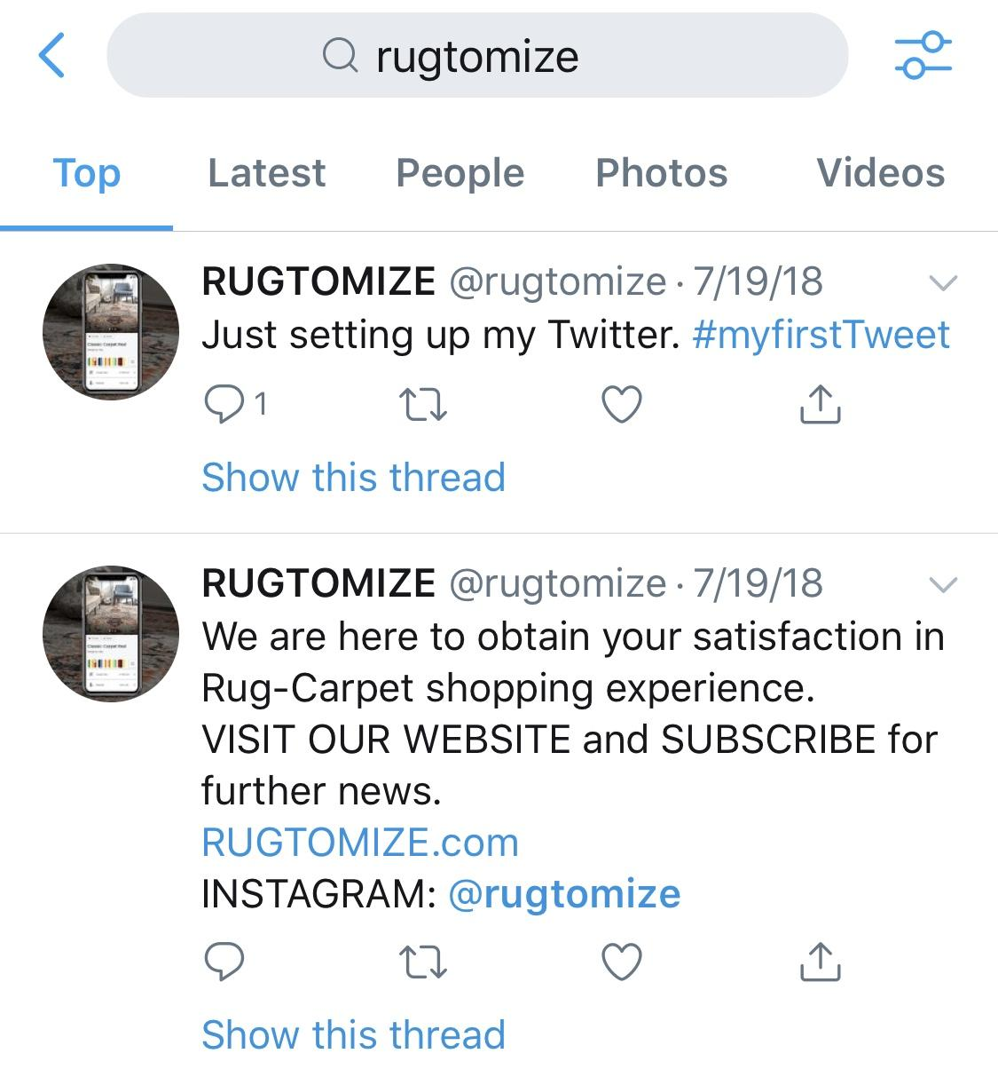

Slide 10
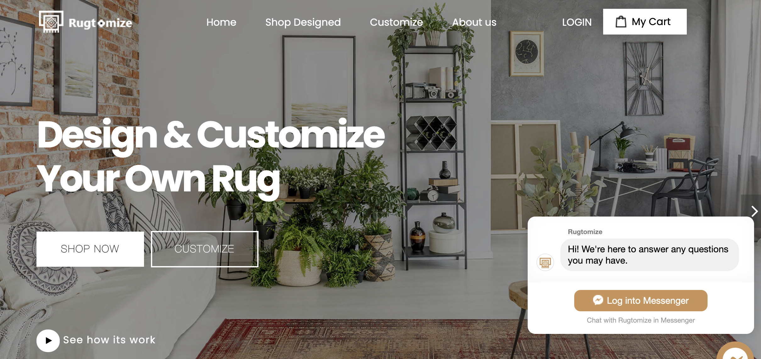
Our goal before we worked with the Company
To help build brand awareness
Use the tools we learned in class to enhance company’s online presence
Use social media platforms
Email newsletters
Notes:
Rashi
They did not launch the website when we started they only had a beta version of it
Hadnt launched the app when we started working with them (thats something we wanted them to focus on)

Slide 11
Steps taken to achieve goal
Analyzed competitors in the field
Researched interior designers in the locality for possible partnerships
Conducted surveys for the B2B and B2C channel to help with pricing strategy
Analysed the social media presence before the project to suggest possible improvements
Analysed the impact of influencers in the customizable interiors space
Notes:
zohra

Slide 12
Traditional Marketing tools used
Chapman radio
Magazines investigation
TV advertisement- agreed that it is too early
Possibility of referred Marketing through influencers

Slide 13
What we did
Captioned many of the media posts provided to us
Found relevant hashtags
Looked into Ads (Google, Facebook)
Conducted surveys
B2B , B2C, B2Interior Designer
Determined the target audience
Contacted Chapman Radio
Found magazines to advertise on
DM influencers
Found best times to post on social media
Notes:
Rashi

Slide 14
Instagram

Slide 15
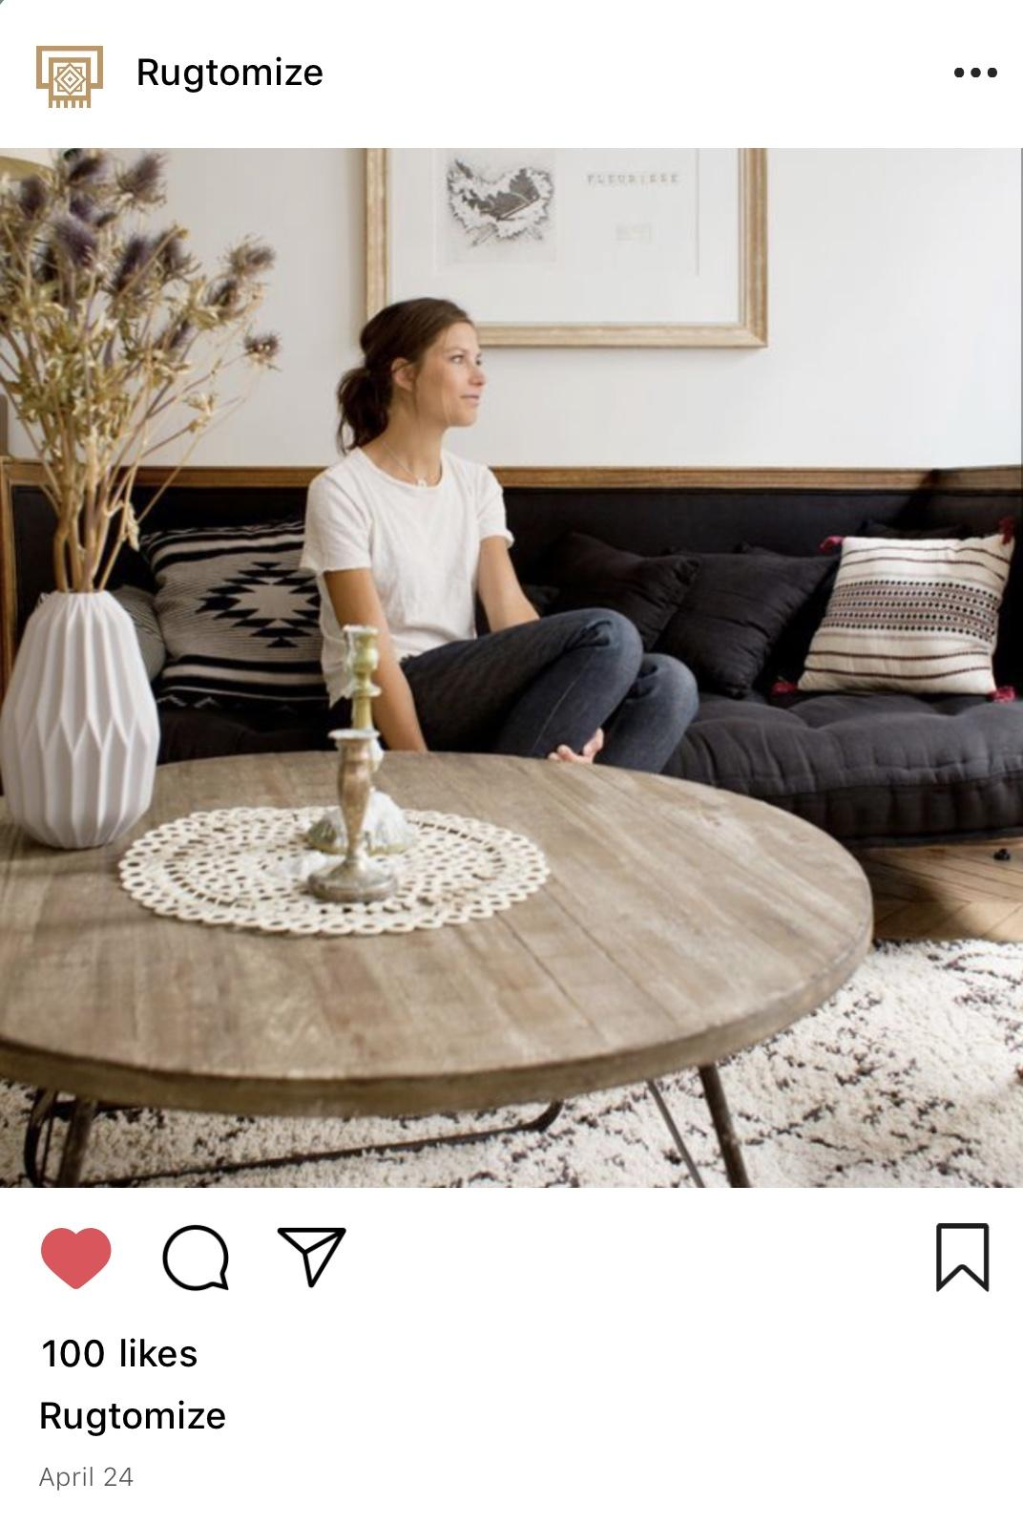
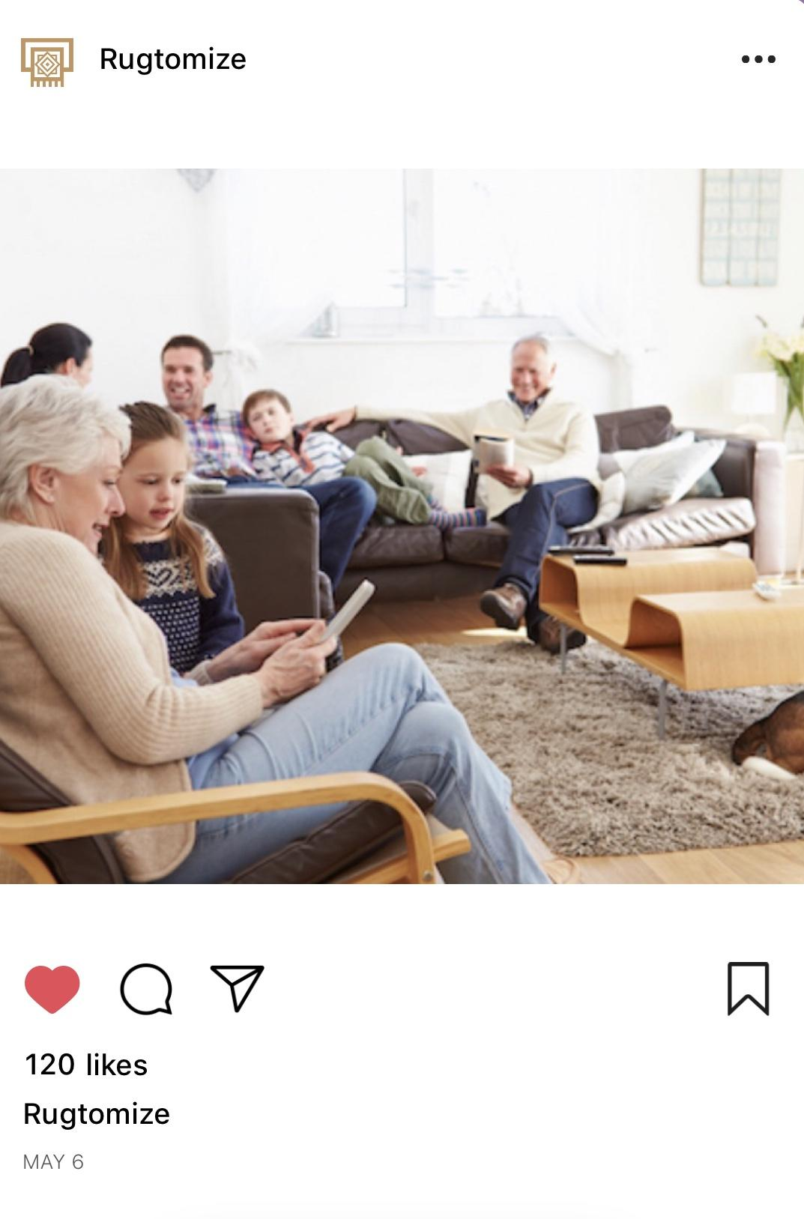
New Posts
Incorporates people
Helps the audience relate and feel more connected to the image
Intriguing captions
Don’t simply seem like an ad
Better and more targeted hashtags
Tags
Interior designers, partners, influencers
Here’s a tan-tastic rug that will go with any room and any personality. But if you’re not a fan of tan, we have plenty of other colors and patterns to choose from! #CustomRug #YourIdeas
Family get togethers are never boring, your rug shouldn’t be either #CustomRug#RugLife #Customize
Notes:
kaelyn

Slide 16
Our Recommendations
Sales and Marketing confusion - Separate the two
Investigate further the traditional ways of Marketing
2 type posts on Social Media = “Sell Post + Story Post” + hashtags
Insta story- Customer involvement
Investigate in SEO
Hurry with the production - that has been hindering some of the digital posts that could have been made.
Put people in their social media posts- helps viewers relate
Post more often on Pinterest and Twitter
Notes:
Kaelyn
Relate to slide 4

Slide 17
Thank you!

